Slide 1
The Big Church Survey (and other animals)
Dr Bev Botting
Research and Statistics
National Deaneries Network Conference
Hayes Conference Centre, Swanwick
Saturday 6 October 2018

Slide 2
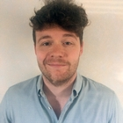
Research and Stats Team (Other animals!)
Bev
C11
Ken
C2
Alan
Sam1
C2

Slide 3
Continued…
Sam
Bertie
William
Fraser
Louise
Sola
Geraldine
Simeon

Slide 4
Purpose of the Research and Statistics team
To support the mission of the Church of England by working to ensure that high quality data are collected and appropriately used in decision making at local, regional, and national level.
Notes:
It’s really important to emphasize the joined-up nature of our work. The aim is to support evidence-based decision making. This requires timely and accurate data. Better data sharing and time spend enabling diocesan colleagues (& others) to understand, manipulate, and use their data help with both accuracy and timeliness. Sharing data in accessible ways with parishes is a key part of this too – if churches don’t think anyone uses the information, why would they bother filling in all these forms? If churches don’t get anything out of it, why would they bother ensuring the figures are accurate? If they can’t see gaps and historical figures, how will we ever improve the quality of the archive?

Slide 5
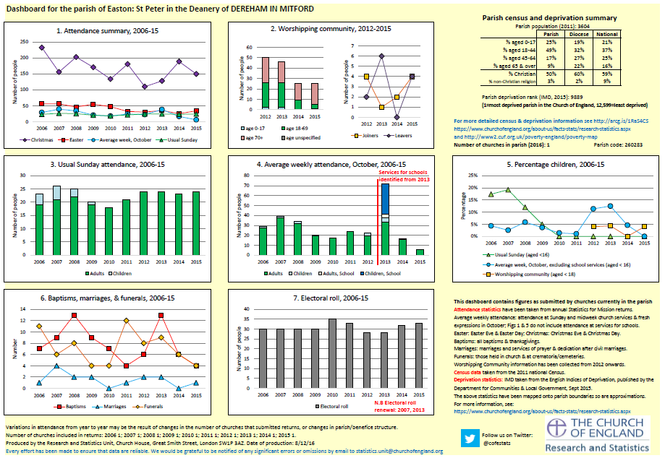
Parish Dashboards – attendance, census, participation, deprivation

Slide 6
Parish Finance Dashboards – income, expenditure, giving, givers

Slide 7
Online Parish Returns System

Slide 8
Deanery Dashboards – attendance, census, participation, deprivation

Slide 9
Deanery Finance Dashboards – income, expenditure, giving, givers

Slide 10
Research & Statistics team – funded projects
Articles of Enquiry
Online service register
Renewal and Reform Programme – SDF funded projects:
The Big Church Survey
Fresh Expressions
Lay Ministry
‘Collect once use many times’ technology data projects

Slide 11
Renewal and Reform – Big Church Survey
The aim is for the Church to understand better key demographic and behavioural characteristics of the people in its congregations, such as age, ethnicity and gender, frequency of worship and distance travelled to church.

Slide 12
Renewal and Reform – Big Church Survey
Everyone in church will be asked to provide key information about themselves. The design of this survey will minimise costs by capturing the data electronically
A steering group will be formed in October 2018, to design the survey methodology and the questionnaire used.
A small number of churches will pilot the questionnaire in November 2018,
The first sample of churches will be selected during spring 2019 and invited to take part in the survey during May 2019.
Churches will receive short summary reports about their congregation during September 2019;
Findings from the first survey will be presented at the Faith in Research conference in May/June 2020.

Slide 13
Renewal and Reform – Fresh Expressions
The aims are to:
better understand the contribution of Fresh expressions to the breadth of worship and to church growth.
help improve our understanding of the number of churches, we aim to identify and better quantify the number and size of fxC. It is not known currently, how many fxC there are.
gain a better understanding of the life cycle of different types of fxC and the factors that influence this.

Slide 14
Renewal and Reform – Lay Ministry
The aim is to have a clear understanding of the breadth and depth of lay ministry and to provide an effective mechanism for ongoing monitoring of lay ministry. There is an emerging categorisation of lay ministries as licensed, authorised or recognised. This planned work will aim to quantify in each of these areas.
R&S has published previously numbers of licenced lay readers. This new work will bring together different sources of information on lay ministry already happening or planned in dioceses to help quantify the scope, range and number of those in lay ministry.

Slide 15
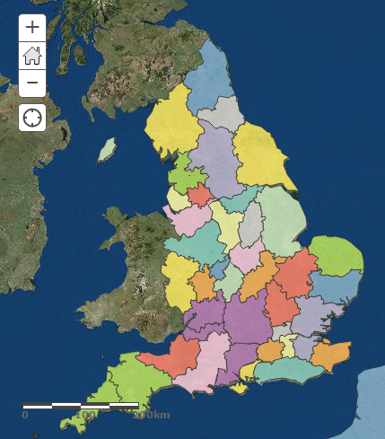
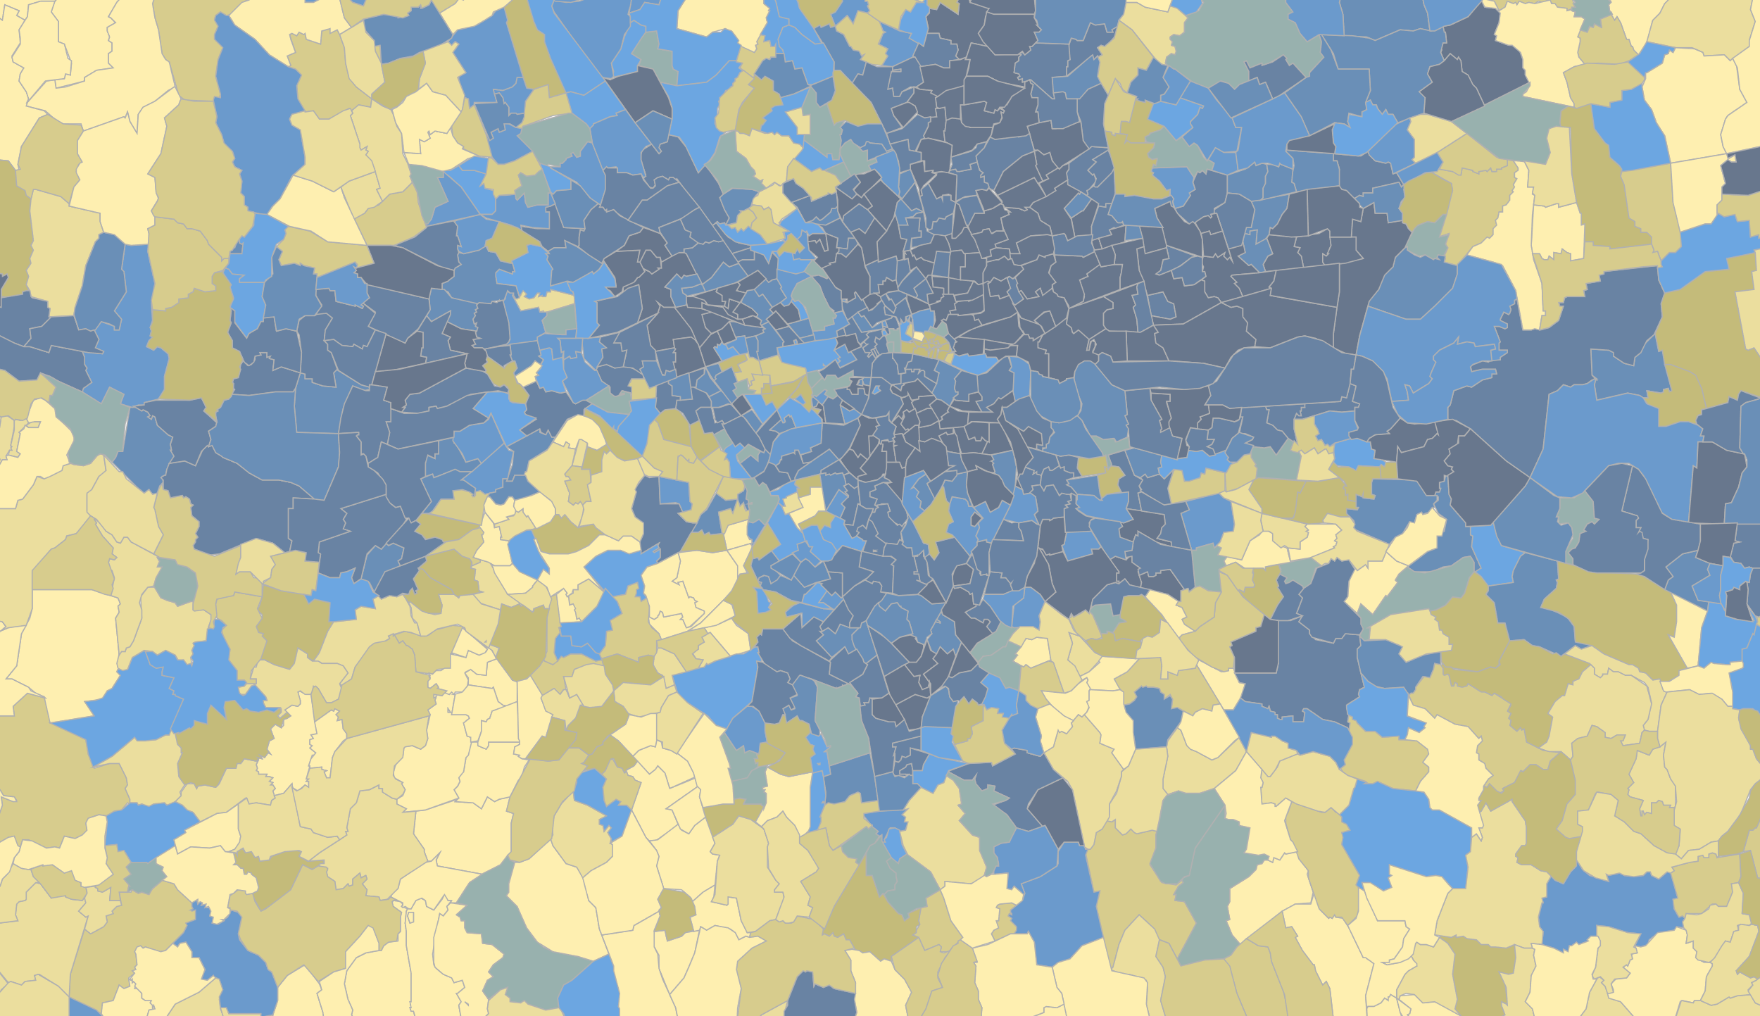
Other animals
Four Published Annual Reports
Statistics for Mission
Parish Finance
Ministry
Cathedrals (and Chapels)
Mapping are saveable, ed alter. And free
These maps are saveable, editable, alterable.
And free to use. saveable, editable, alterable. And free to use.
https://www.churchofengland.org/about-us/facts-stats/research-statistics.aspx
Contact us!
https://www.churchofengland.org/more/policy-and-thinking/research-and-statistics
Email: statistics.unit@churchofengland.org
Twitter: @cofestats
Parish Census and Deprivation Resources

