Slide 1
finding God in everyday life
waking up: taking a stand: acting on nudges

Slide 2
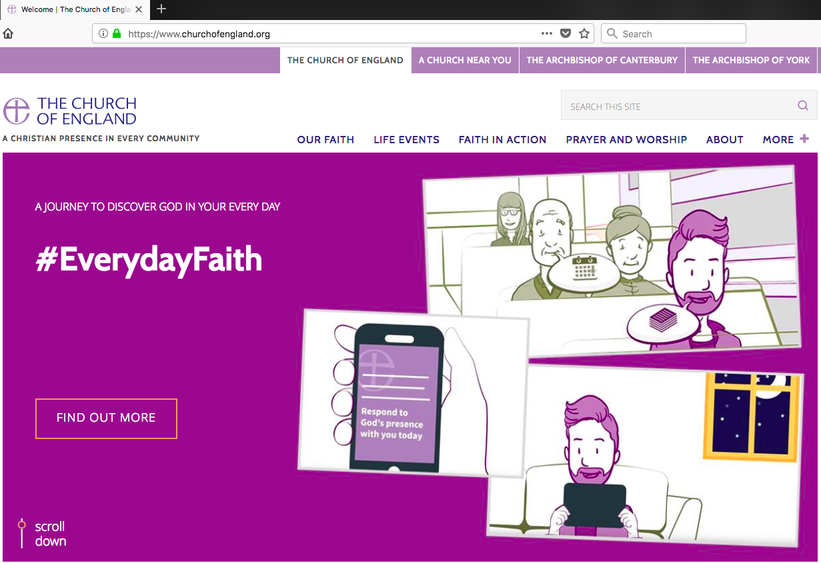

Slide 3
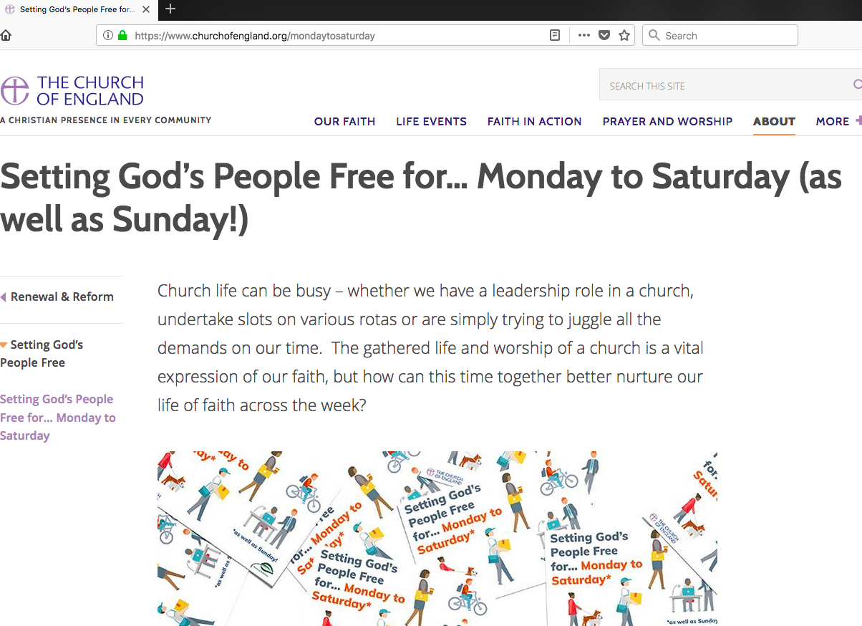

Slide 6
waking up: being curious about God in everyday life
ask curious questions
visit people in context

Slide 8
taking a stand: being confident kingdom seekers in everyday life
this time tomorrow
sunday praying for mon-sat living
what’s noticed

Slide 10
acting on nudges: Being courageous in following God’s promptings in everyday life
commissioned & sent
preaching & testimony

Slide 11
finding God in everyday life
The one thing we will do differently?

