Slide 1
National Deanery Conference 2014
Unlocking the Mystery of Reaching Young Adults
Notes:
5 - Intro – who we are, why we’re here etc – story from Steve

Slide 2
The Missionary Challenge
Notes:
5 minutes on the challenge

Slide 3
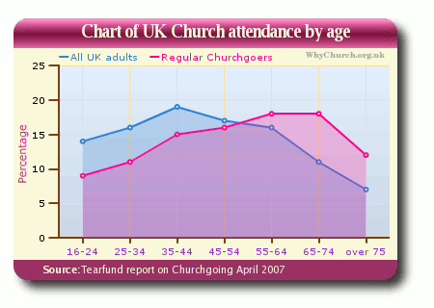
Notes:
When you break down the church going numbers to ages then it’s really dire for those under 35. Stats show that if you’re connected to a church in your 20s then you’re likely to be connected for life. The problem isn’t people in their 20/30s leaving it’s that they never belonged in the first place.

Slide 4
Notes:
20 minutes on research. But some things are working with young adults and seeing new expressions of church. Intro to research – who, when, where etc.

Slide 5
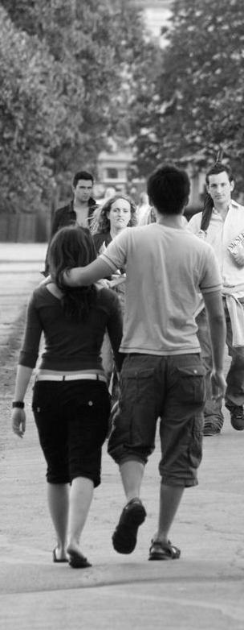
Background issues
Young adult movement
Sociological Development
Different streams of young adults
Implications

Slide 6
Research model
Small scale qualitative research
Grounded theory approach with theoretical sampling
Young adult definition
Twelve representative churches

Slide 7
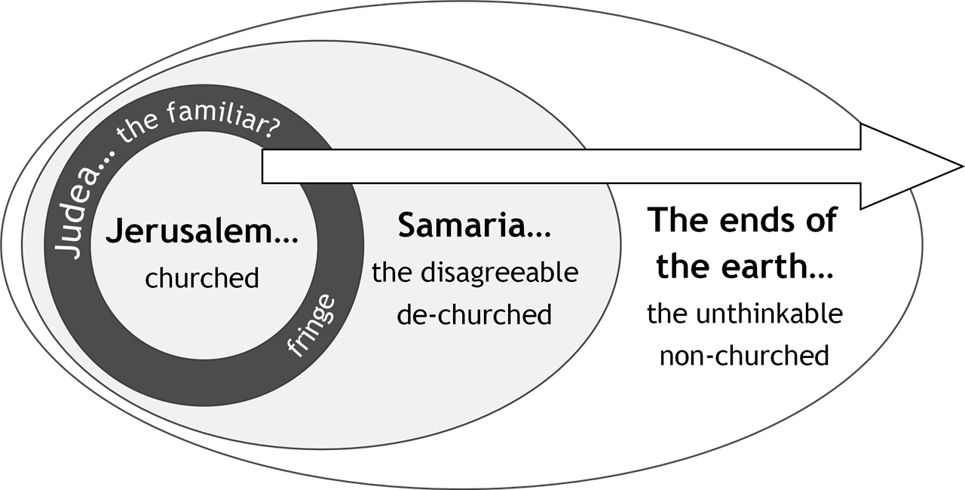
G.Lings, Encounters on the Edge, 30, (Sheffield: The Sheffield Centre, Church Army, 2006) (16-20)

Slide 8
The spread of churches examined on the Jerusalem to the ends of the earth spectrum

Slide 9
Leader | Church | Location
Andy Croft | Soul Survivor Watford | Watford
Bryony Wells | Life Church, St Thomas’ Church Crookes | Sheffield
Harry Steele | Uncut, part of All Saints Ecclesall, then St Peters, Greenhill | Sheffield
Mark Broomhead | Order of the Black Sheep | Chesterfield
Rich Atkinson | Rebuilding Generation, St Toms, Philadelphia | Sheffield
Shannon Hopkins | Matryoska Haus | London
Steve Leach | Unnamed group plus Church for the Night | Bournemouth
Carol Wain | 11.57 | Liverpool
James Henley | The Lab | Newport
Nick Russell | Church Army Centre of Mission | Greenwich
Sarah Belcher | Monks Rd Congregation, Threshold | Lincoln
Steve Clarke | FEIG | Gloucester

Slide 10
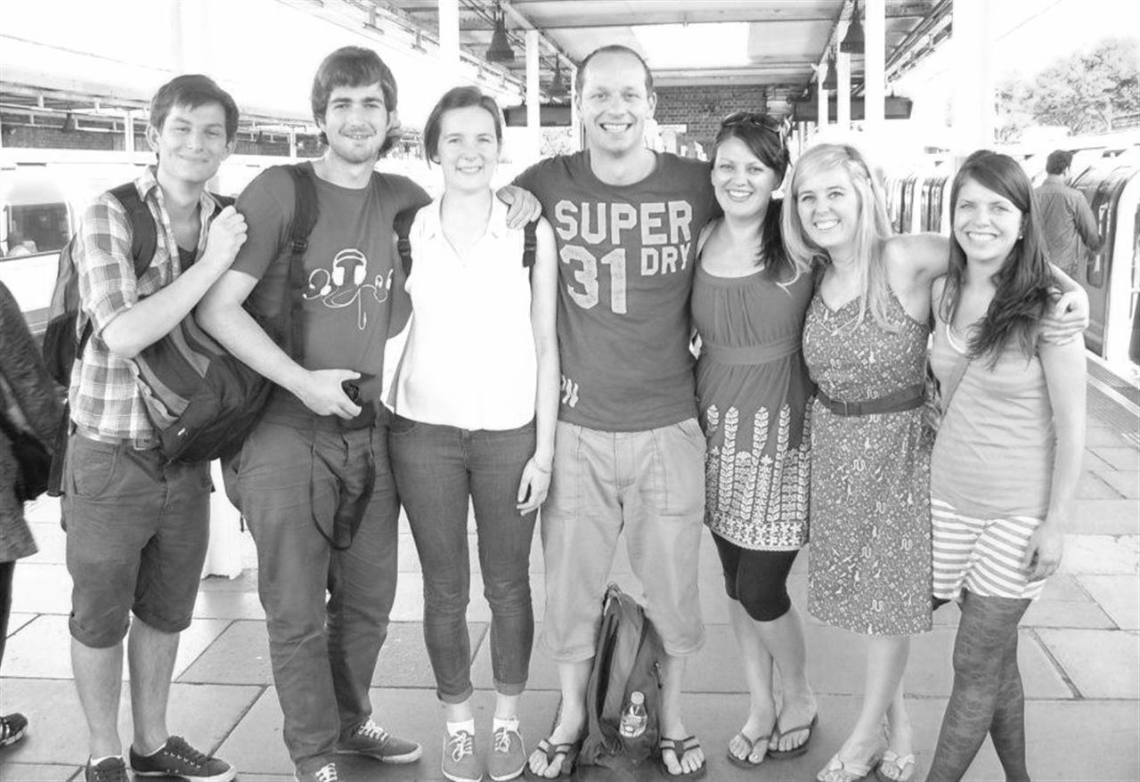
Community

Slide 11
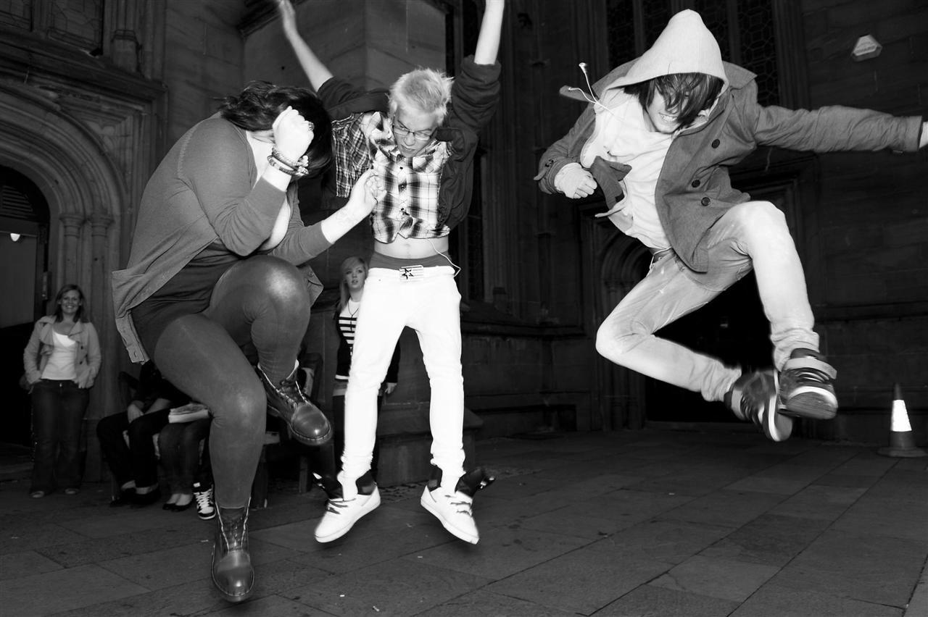
Authenticity

Slide 12
Doubt

Slide 13
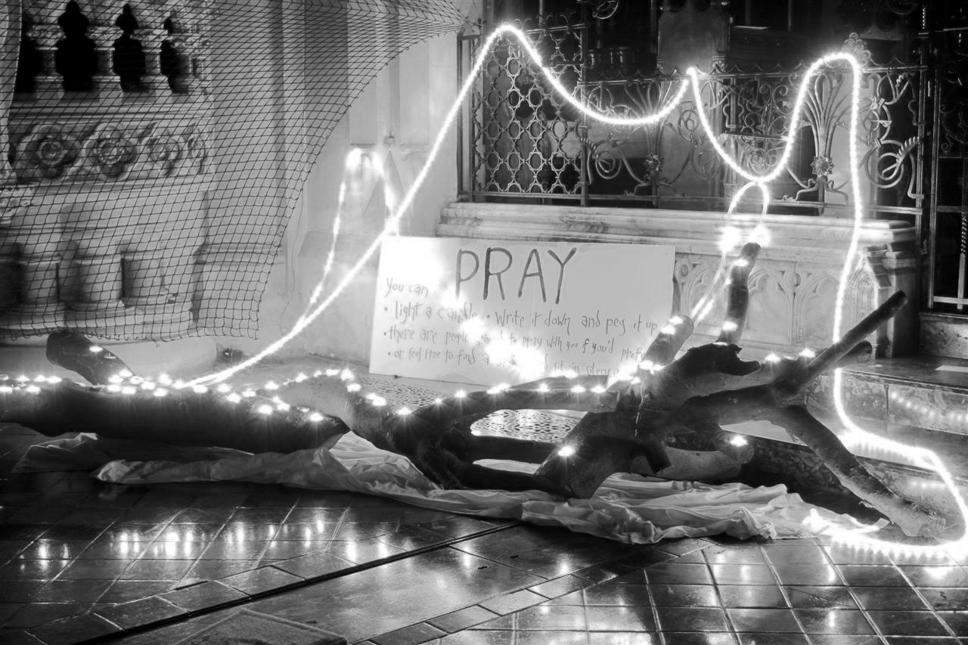
Spirituality

Slide 14
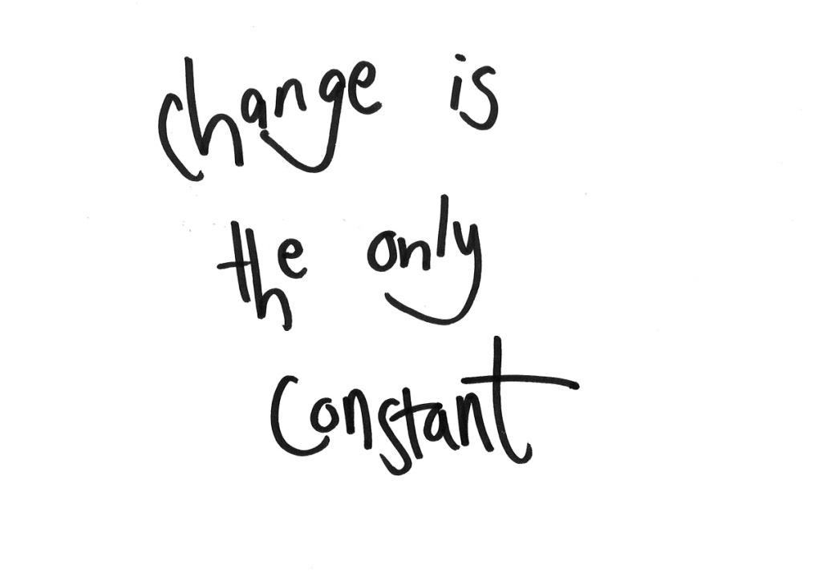
Change

Slide 15
1. Church planting hubs
“How do we retain and attract
more young adults?”
Notes:
These are big, lively and growing. However they tend to only attract those with some Church experience and draw them back in (Jerusalem, Judea & bits of Samaria). As these groups shrink each year there will be less people to draw on. One church leader confessed that while the church had grown they had not actually seen anyone from outside ‘church’ join them in years. But perhaps these churches contain potential leaders who are willing to go to the ends of the earth...

Slide 16
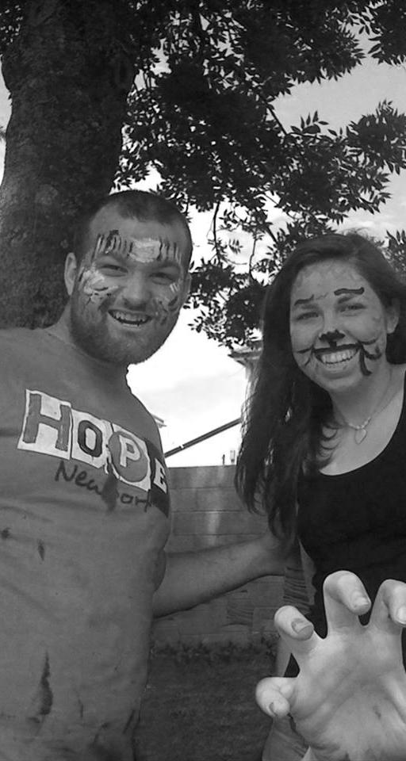
2. Youth church grown up
“How do we grow up into adult church for us?”
Notes:
Interestingly whatever background the youth group came from by their 20s this tended to be a middle class group.

Slide 17
3. Deconstructed church
“What is Church?”

Slide 18
4. Church on the margins
“What is gospel transformation for the poor?”

Slide 19
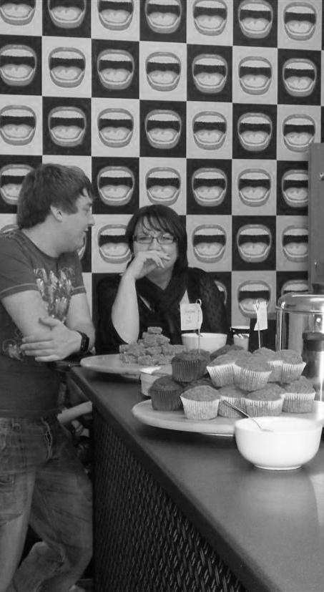
5. Context shaped church
“What is Church in this context?”

Slide 20
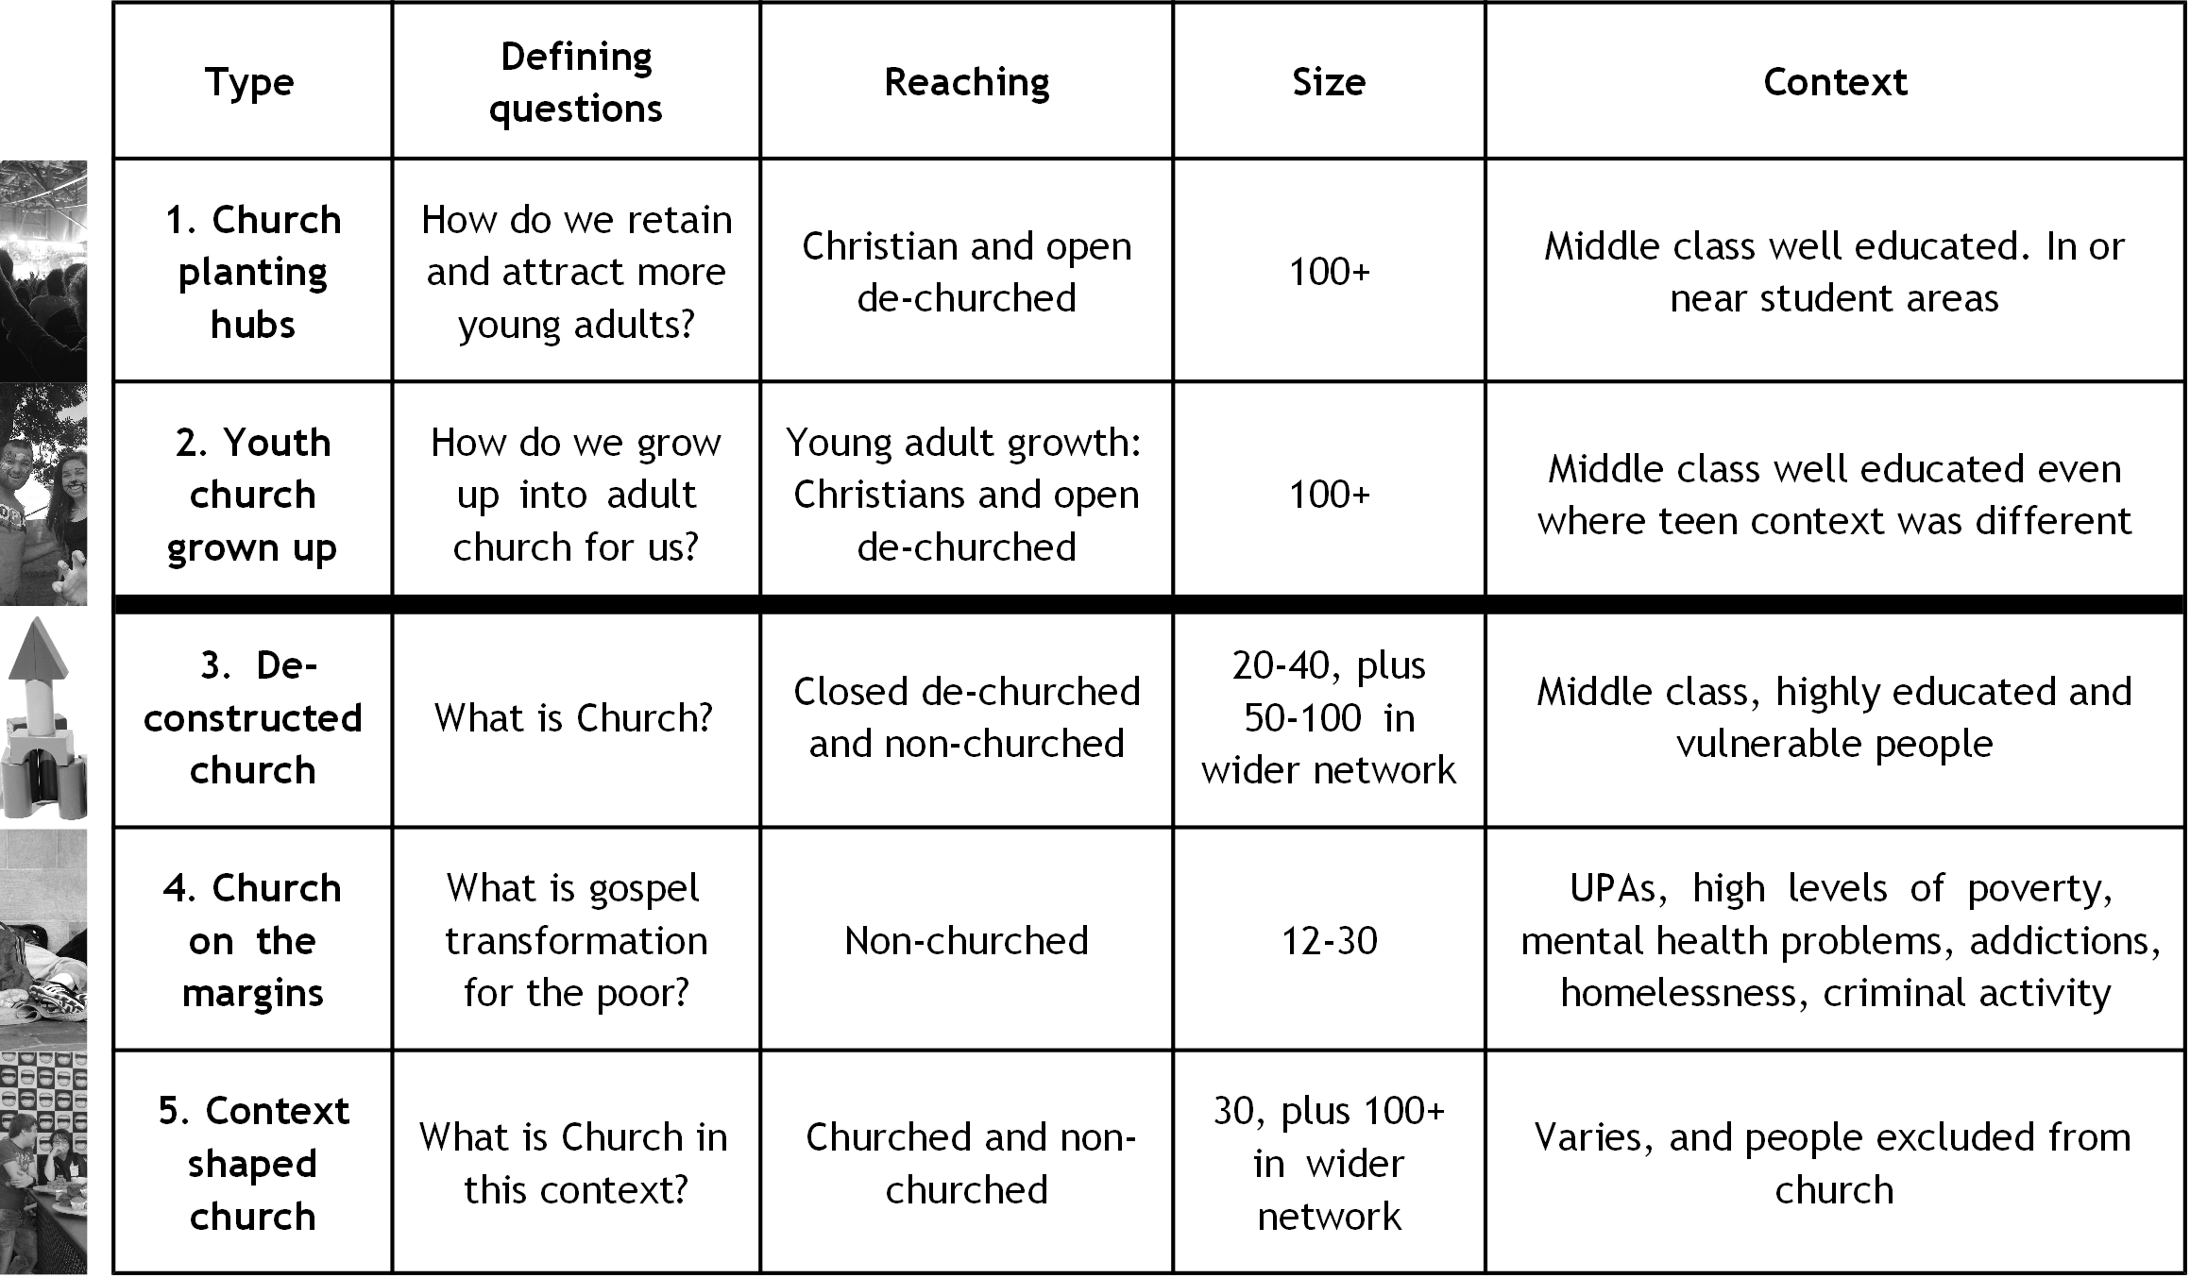

Slide 21
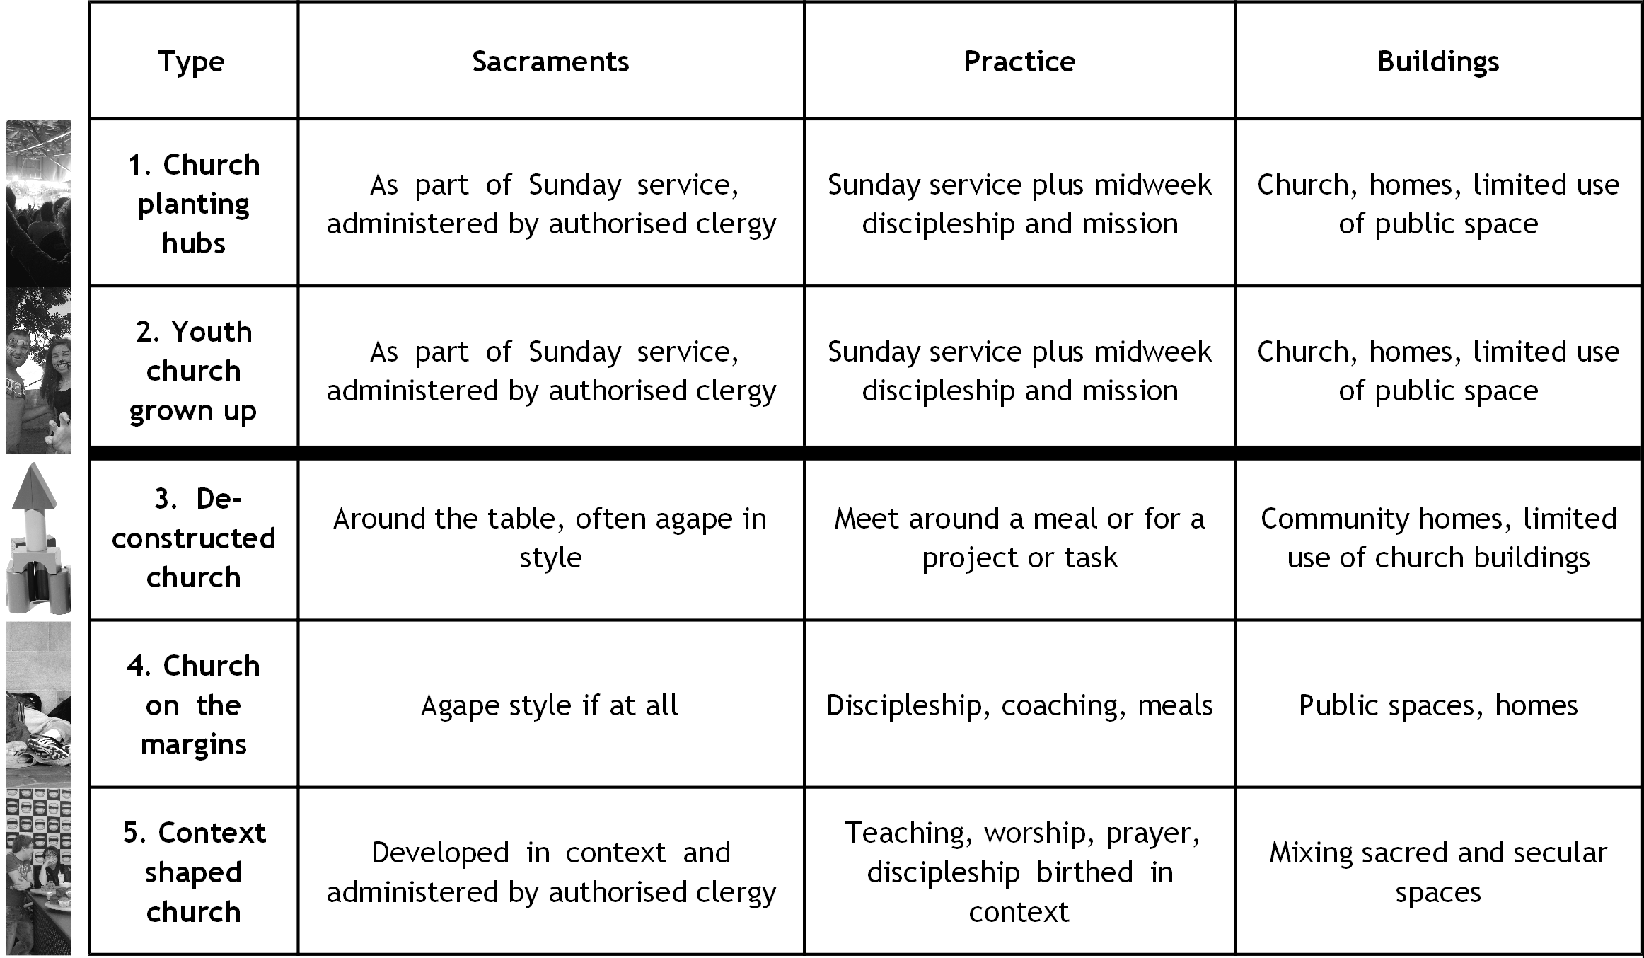

Slide 22
Wider issues
Leadership
Ecclesial tradition
Connection to the wider Church
Size and sustainability
Notes:
Different groups faced different challenges. Types 3,4 & 5 with a paid leader struggled when they moved on (e.g. OPM) but those without had a constant lack of resources. The size and success of each group was not affected by the style of leadership and all grew to the same size regardless of whether the leader was paid, trained, ordained, male or female.

Slide 23
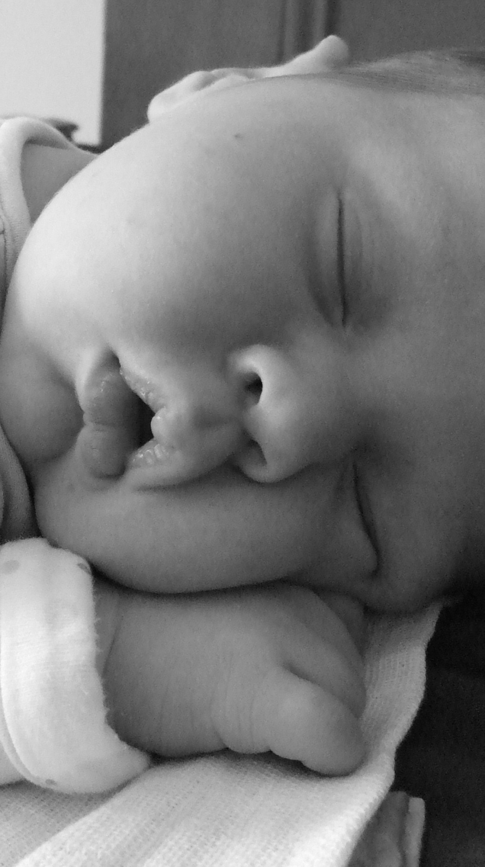
Just a life stage?
Notes:
Surely once a young adult marries and has kids they all return to church?!?! Those in 3, 4 & 5 don’t cross over into church as we know it so these are set to continue. As those with church backgrounds shrink these will become increasingly important.

Slide 24
Recommendations
Recognise the different types
Access to community homes
Acknowledge small sacramental communities
Supportive connections to wider church
Value the vocational role of church planting hubs
Provision for youth churches growing up
Diocesan posts to support existing and start new young adult churches

Slide 25
In small groups what are your reactions and questions after hearing this...?
Notes:
10 minutes for discussion, 5 minutes for feedback and questions that we’ll answer at the end.

Slide 26
Some stories...
Notes:
5 minutes each = 15 minutes

Slide 27
Where do we go from here...?
(ideas to get you started)
1 – Listen: God, context, wider thinking
2 – Who do you already have? How can you support them in mission?
3 – Who did you have? Are they still around to talk to? Where have they gone?
4 – Advocate wherever you are for young adults
5 – Get a copy of ‘Authentic Faith’
6 – Keep up to date with news from Fresh Expressions & Young Adults
(www.freshexpressions.org.uk/youngadults)
7 – Invite us to your context
(penny.stradling@cms-uk.org / 01865 787415)
Notes:
5 minutes

Slide 28
Questions...
Notes:
Until the end – +/- 25 minutes

