Slide 1
Mental Health & Faithfulness
in an Age of Anxiety
Rob Merchant @robmerchant
stmellitus.ac.uk | @stmellitus

Slide 2
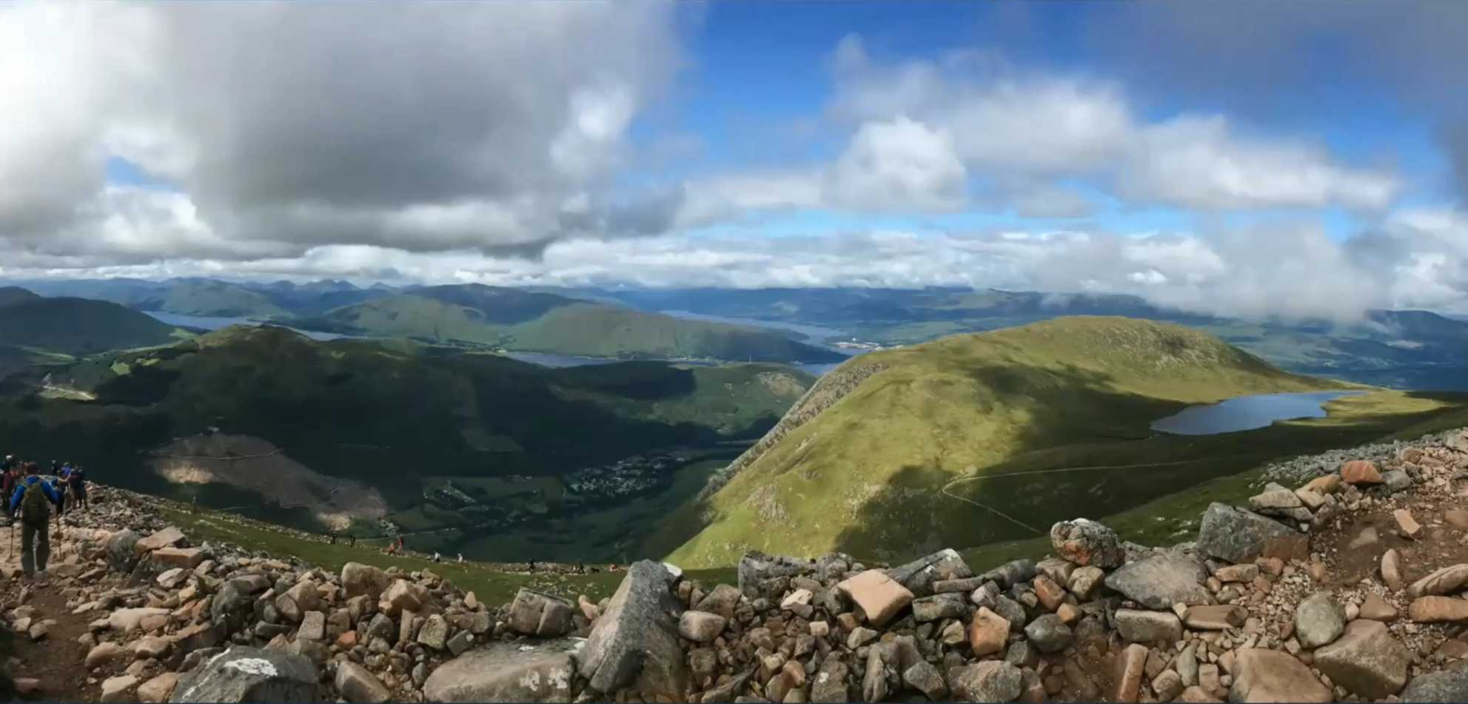

Slide 3
Break out rooms
Groups of 3-4
5 minutes
Who are you / where are you as you journey down the mountain?
This is a quick ‘snap-shot’ moment & using story & image means we don’t need to get too personal to quickly.

Slide 4
Honesty... we all carry our own story
"It is God's grace that is first... we do not change in order to experience grace. God meets us where we are and in his peace our pain can surface and he meets us in our woundedness. Because of God's grace we do not have to conform and perform for acceptance. These aspects of... teaching had a profound effect on me. The pain of wounds surfaced more strongly and I gained a freedom to be who I am without having to perform ana pretend. I am not ashamed of being me any more. The process was long, slow and very painful at times. Of course, it is not complete."
A correspondent quoted in Stephen Pattison, Shame: Theory, Therapy, Theology, 2000,
Cambridge University Press, p274

Slide 5
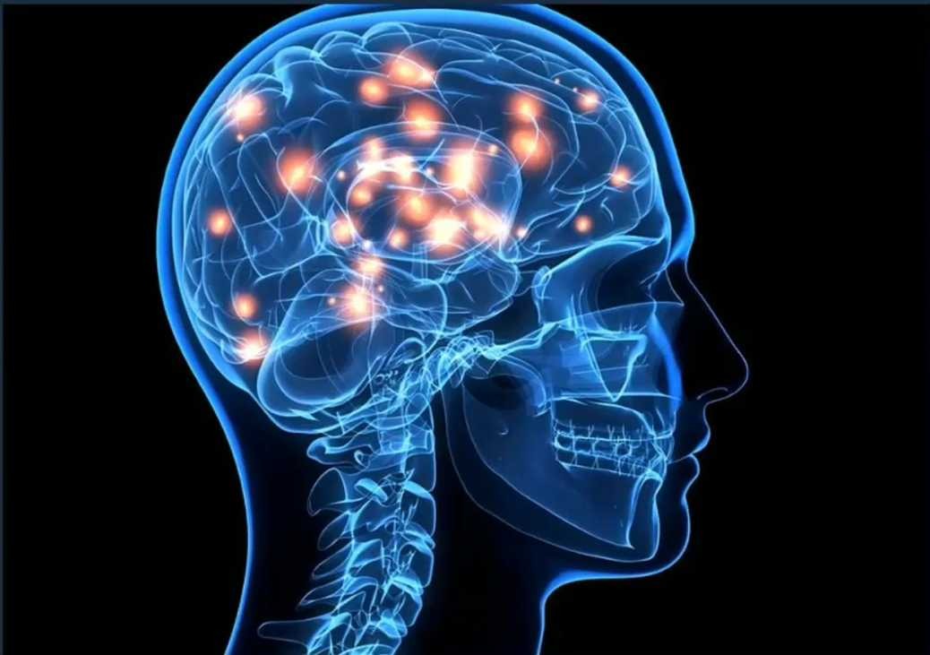
Approximately 1 in 4 people in the UK will experience a mental health problem each year.
In England, 1 in 6 people report experiencing a common mental health problem (such as anxiety and depression) in any given week.

Slide 6
"We now know that trauma compromises the brain area that communicates the physical, embodied feeling of being alive. These changes explain why traumatised individuals become hypervigilant to threat at the expense of spontaneously engaging in their day-to-day lives. They also help us understand why traumatised people so often keep repeating the same problems and have such trouble learning from experience. We now know that their behaviours are not the result of moral failings or signs of lack of willpower or bad character - they are caused by actual changes in the brain."
Bessel Van Der Kolk, 2014, The Body Keeps the Score: Mind Brain and Body in the Transformation of Trauma, p3

Slide 7
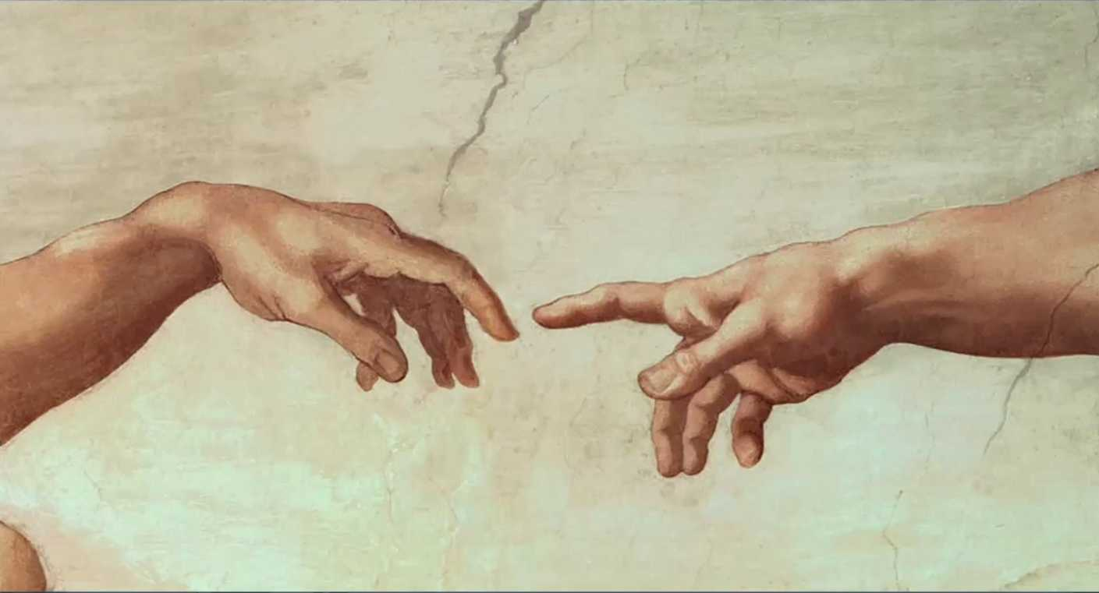
Michelangelo: the Creation of Adam

Slide 8
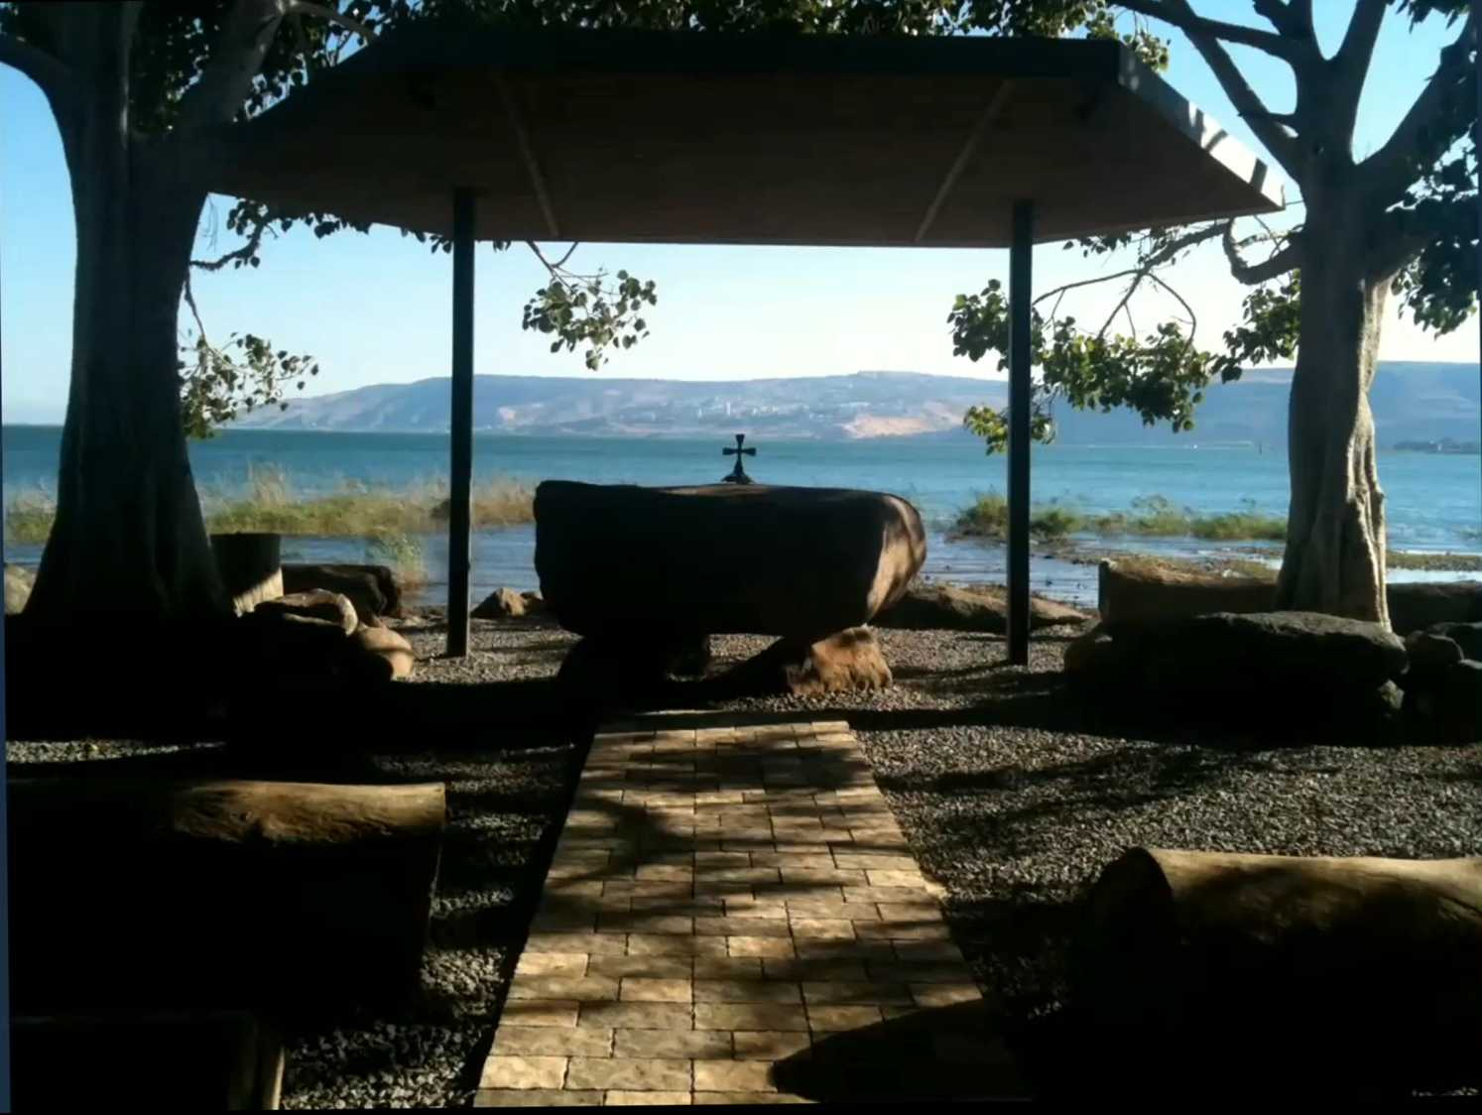

Slide 9
Break out rooms
Groups of 3-4
5 minutes
What’s not been okay?
This is a moment to take a deeper step, you don’t need to share lots of detail, but give one another the gift of being heard.

Slide 10
Top tips
Know the signs to spot
Well being check up
Stress bucket
Online tools
Mindfulness
5,4,3,2,1
Breathing

Slide 11
Mental health triggers can include:
Personal life changes e.g.
Bereavement
Relationship breakdown
Having children
Health scares or physical illness
Changes at work e.g.
Starting a new job
Coping with an increased workload or promotion
Poor relationships with colleagues or managers
Redundancy, or fear of redundancy

Slide 12
Signs to spot
Physical can include:
Frequent headaches or upset stomachs
Suffering from frequent minor illnesses
Difficulty sleeping or constant tiredness
Being run down
Lack of care over appearance
Sudden weight loss or gain

Slide 13
Signs to spot
Emotional & behavioural;
Irritability, aggression or tearfulness
Being withdrawn not participating in conversations or social activities
Increased arguments with others
Increased consumption of caffeine, alcohol, cigarettes or sedatives
Indecision, inability to concentrate
Erratic or socially unacceptable behaviour
Being louder or more exuberant than usual
Loss of confidence
Difficulty remembering things
Loss of humour.

Slide 14
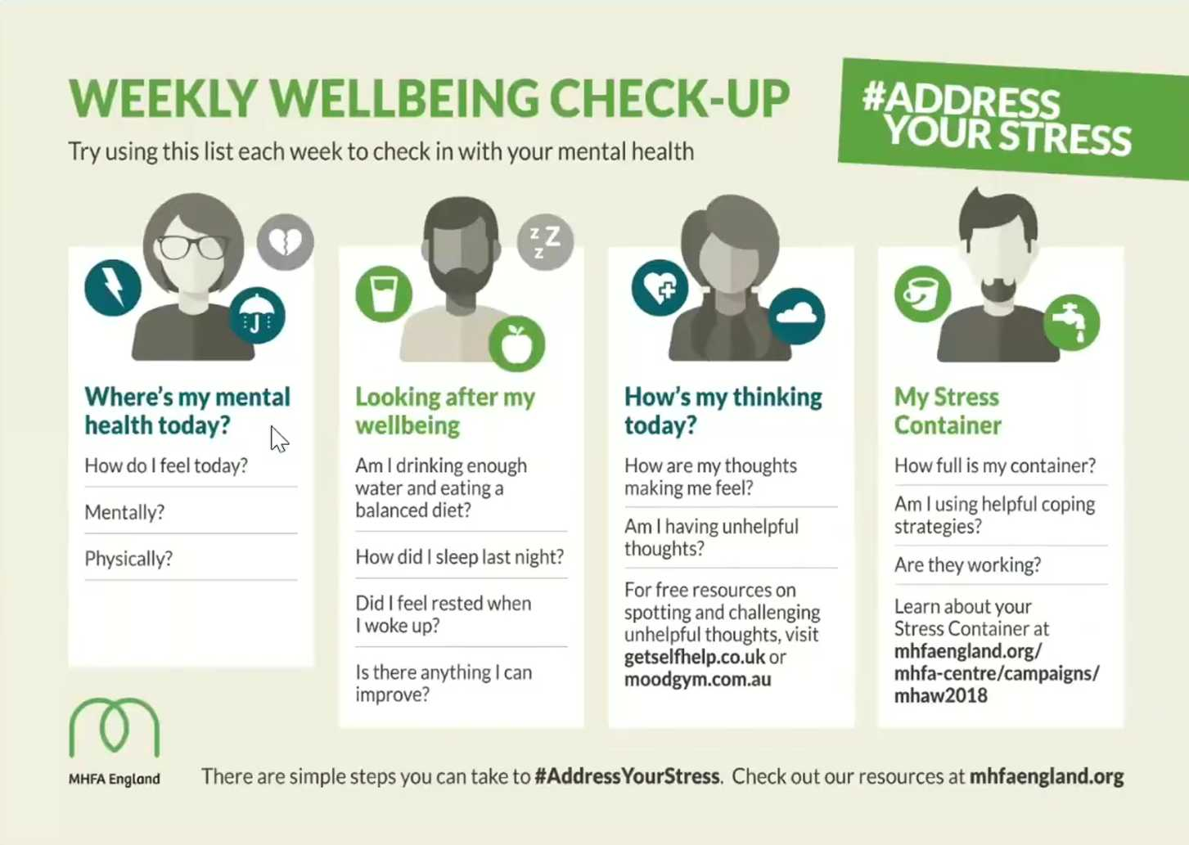

Slide 15
The stress bucket

Slide 16
https://www.nhs.uk/conditions/stress-anxietv-depression/mood-self-assessment/
https://www.moodscope.com
https://www.nhs.uk/apps-librarv/categorv/mental-health
https://www.mind.org.uk
https://www.time-to-change.org.uk
https://www.mentalhealth.org.uk

Slide 17
Mindfulness
“....mindfulness can be described as being fully aware of your own experience in the present moment in a non-judgmental way. There are four vital strands to this definition: awareness, experience, the present moment, and non-judgment....”
“...many will... argue that something very similar to mindfulness has been around in the Christian tradition...We haven’t called it mindfulness. We’ve called it ‘silent prayer’ or ‘contemplative prayer’, ‘the desert tradition’, or ‘mystical theology’....”
Tim Stead, Mindfulness & Christian Spirituality: Making space for God, SPCK, p6, p18

Slide 18
5-4-3-2-1 Coping Technique for Anxiety
5: Acknowledge FIVE things you see around you. It could be a pen, a spot on the ceiling, anything in your surroundings.
4: Acknowledge FOUR things you can touch around you. ...
3: Acknowledge THREE things you hear. ...
2: Acknowledge TWO things you can smell. ...
1: Acknowledge ONE thing you can taste.

Slide 19
Breathing
Lots of good recommendations, to try is on:
https://www.nhs.uk/conditions/stress-anxiety-depression/ways-relieve-stress/
4-7-8 breathing (4 inhale, 7 hold, 8 exhale)
7 then the Lord God formed man from the dust of the ground, and breathed into his nostrils the breath of life; and the man became a living being. (Genesis 2.7, NRSV)

Slide 20
Break out rooms
Groups of 3-4
5 minutes
Sharing our own ‘top tips; what has sustained you?
This is an opportunity to encourage by noticing what we have found helpful and to wonder what we might try.

Slide 21
Hope & the eschatological disciple...
5 Therefore, since we are justified by faith, we have peace with God through our Lord Jesus Christ,2through whom we have obtained access to this grace in which we stand; and we boast in our hope of sharing the glory of God.3 And not only that, but we also boast in our sufferings, knowing that suffering produces endurance,4and endurance produces character, and character produces hope,5 and hope does not disappoint us, because God's love has been poured into our hearts through the Holy Spirit that has been given to us.
(Romans 5.1-5, NRSV)

Slide 23
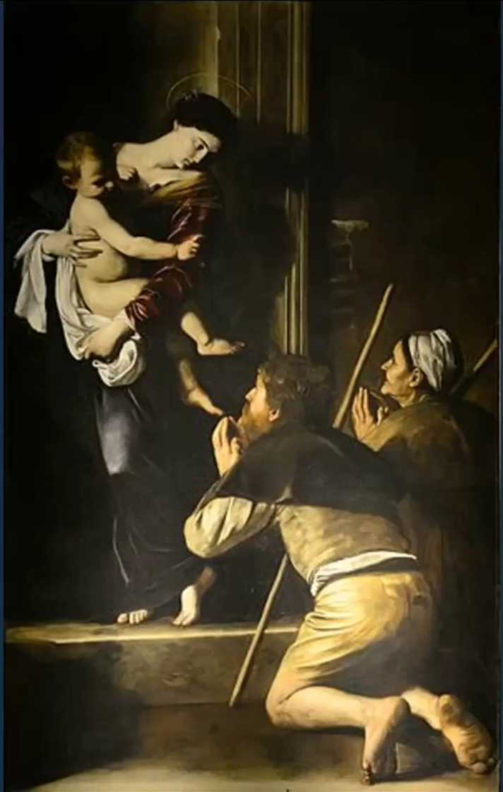
Caravaggio: Pilgrim’s Madonna, 1604

