Slide 1

Leadership and the art
of collaboration
and persuasion
Peter Farley-Moore
Archdeacon of Hackney

Slide 2


Slide 3
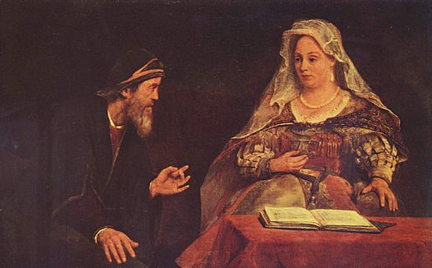
For such a time as this....
Esther and Mordecai" by Aert de Gelder (Museum of Fine Arts Budapest)

Slide 4

For a vision to offer hope,
it must emerge realistically
from the situation in which
we find ourselves today.
Only then can it transcend
the present and point us to
tomorrow.
Walter Wright Relational Leadership

Slide 5
Leadership and the art of collaboration and persuasion.
Archdeacon of Hackney
Diocesan Governance
Pastoral Reorganisation
Clergy: Pastoral Care and discipline
Buildings and Property
Parochial Governance
Episcopal Area
and Mission

Slide 6
Leadership and the art of collaboration and persuasion.
Church Warden
Diocesan Personnel and Structures
Musicians, choir, youth workers
Clergy household support
Buildings and Property
PCC and Ministry Team
Sundays and Occasional Offices

Slide 7

“leaders must become
learners themselves
by acknowledging
their own weaknesses
and vulnerabilities”
(page 37)

Slide 8
“The good news: employee engagement, empowerment, organizational agility, ambidexterity, innovation...all of this can flourish in the rapidly changing world when the fundamental relationship between leaders and followers, helpers and clients, and providers and customers becomes more personalised and cooperative”
Humble Inquiry, Schein. P1

Slide 9

“Personhood as opposed to individualism, sees relationship with others as the very ontological structure of humanity...We are relationships, they are the very core of our existence, the source of life.
As Jewish thinker, Martin Buber said, ‘In the beginning was relationship.’”
Andrew Root, The Relational Pastor. p18

Slide 10
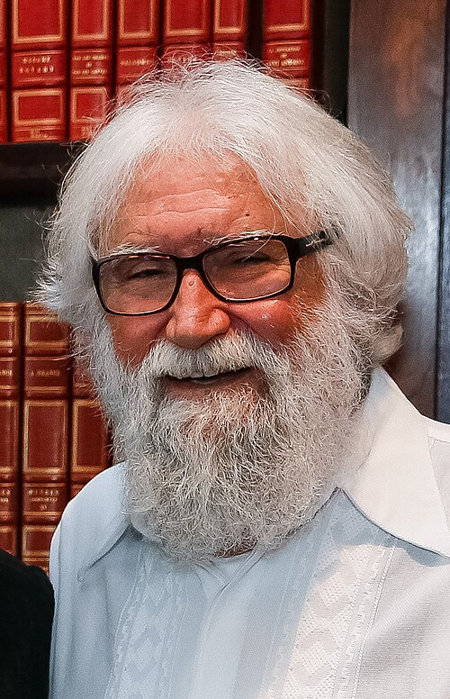
“Jesus did not live an idyllic life. His existence was a heavy commitment, weighed down with conflicts that culminated in his crucifixion.
In the midst of these excruciating experiences, he prayed to his beloved Father.
In the end he did not ask to be spared the temptations of the cup of bitterness; he sought faithfulness to his father’s will.”
Leonardo Boff

Slide 11
The biblical art of persuasion and collaboration
John the Baptist
Persuades his people that change is needed.
Jesus
Persuades for 3 years through his teaching and parables.
Peter
Pentecost sermon persuades people that the Holy Spirit has been poured out and “last days” have come.
Paul
  Persuades philosophers in Athens that the unknown God has been made know in Jesus.

Slide 12
Where have you seen effective collaboration and persuasion?
What are the blockers and how might they be overcome?

Slide 13
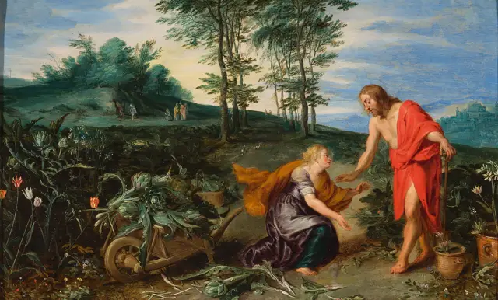
‘Do not hold on to me, but go...’
Image: https://www.fromthedesk.org/mary-magdalene-biography-bruce-chilton/

